Slide 1
National University of Singapore
Teaching Academy
May 20, 2016
Task-based, self-directed (authentic) learning and assessment in the law curriculum
Rick Glofcheski
Faculty of Law
University of Hong Kong
1
Notes:
1

Slide 2
Independent learning
Life-long learning
Deep learning requires engagement and reflection
Design assessment to incorporate independent learning and reflection

Slide 3
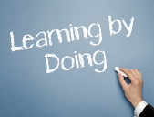
Learning by doing
“Students learn more effectively by doing rather than listening. Listening produces a very low level of learning. If listening and reading are the primary learning activities, and are what students are assessed on, the learning gain is not likely to be substantial. Indeed, listening and reading are very likely to encourage short-term reproductive learning habits rather than more sustainable learning. There is little in such a format that would encourage the development of deep learning, or independent and life-long learning skills.”
(from Glofcheski, “Re-thinking Teaching, Learning and Assessment in the 21st Century Law Curriculum” in Legal Education in the Global Context, Ashgate, 2015)

Slide 4
Reflective Media Diary
1. Student independently identifies tort law-related events as reported in the media
2. Conduct a diary for the first five months of course, of student-selected events reported in the news media; diary requires student legal reflections and some attempt at analysis
5. At conclusion of diary period, student selects 10 items for submission; 6 weeks later, selects 3 events and provides comprehensive legal analysis for submission
3. Web-based email diary to ensure timing and integrity of work (no need for teacher monitoring)
4. Student monitors events as further reported in the media
Learning outcomes: identification and characterization of legal issues in unflagged situations; legal analysis; independent learning;
4

Slide 5

Media reports as authentic assessment
Again, the local newspaper provides a steady supply of material
The material is realistic, authentic, relevant to the community, and constantly being generated
It is generally complex, often requiring multiple perspectives in analysis, including social policy
The material is often factually incomplete, thereby mimicking a realistic professional scenario
Its authenticity and relevance fosters a serious approach to analysis and develops the habit of identifying issues in unflagged situations
The learning is self-managed; knowledge is constructed by the student
Habit-forming, the possibility of life-long learning
The skill acquired holds the real possibility for learning beyond the assessment
5
Notes:
5

Slide 6

Link to RMD samples
http://moodle.hku.hk/mod/folder/view.php?id=619542
6
Notes:
6

Slide 7
RMD Survey conducted by CETL March 2011 - 49 replies
For Qs 1-6 please answer Yes or No.
Did you find the reflective media diary a useful learning experience?
Did you find that the reflective media diary increased your awareness of current tort-related issues of importance in the community?
Did you find that the reflective media diary helped develop your ability to identify and analyse unflagged tort law issues on your own?
Did you find that the reflective media diary project helped develop your ability to think independently about tort law?
If offered the choice all over again, would you still select the reflective media diary project over the research essay option?
Would you recommend that the reflective media diary project be continued in future years?
Are there any other comments that you would like to make about your reflective media diary project experience, including any suggestions for improvement of the project?
Yes (49)
Yes (48)
Yes (47)
Yes (42)
Yes (47)
Yes (48)
See below

Slide 8
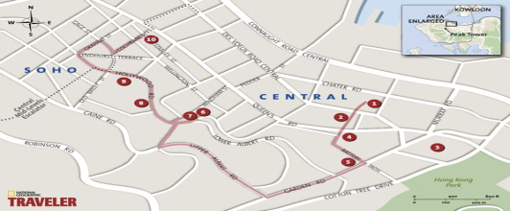
Tort Walk Instructions
Walk into a place or neighbourhood in Hong Kong, maybe one you have never been to before, and try to look for and encounter the tort law dimension. Examples might include a dangerous construction practice, a dangerous pedestrian practice, a narrow shop aisle, road works, instructions to pedestrians or road users, a congested street, illegally parked vehicles, even an ordinary street with its markings and prohibitions, or any place really, that is some way suggestive of a tort law event or situation.
Provide details of the place and time of what you encountered, and the means of the encounter. Your explanation of the potential tort situation should be supported by at most three photographs. You must also provide a legal analysis of the place and circumstances and your experience there. Cite one or two case authorities to support your legal analysis.
You should try to find circumstances that in some way tell the Hong Kong story. What is it about what you see that uncovers how tort law - in particular the creation of risk - takes place in Hong Kong? Try to place what you saw and experienced in the broader social context. What is the social meaning of what you saw and experienced?

Slide 9


Tort Walk Learning Outcomes:
- recognize the relevance of tort law in events as they happen in the community
- more confidently identify tort law issues in unflagged fact situations
- identify and anticipate tort law problems
- recognize how tort law connects to the events of ordinary life
- more confidently provide legal analysis and opinion in unflagged fact situations
Carries either 10% course weighting, or 0% (if the subsequent test exceeds the tort walk score, the test counts for 20% instead of 10%).
http://www.cetl.hku.hk/conf2015/assessment-for-student-learning-in-law-and-beyond

Slide 10
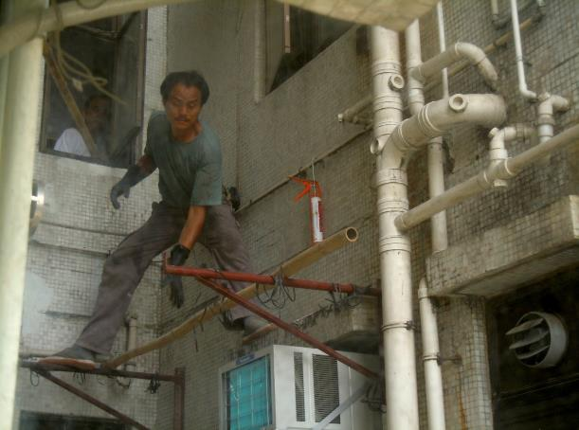

Slide 11
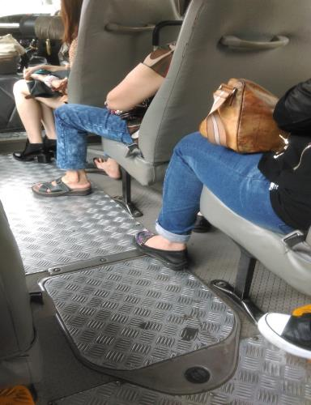

Slide 12
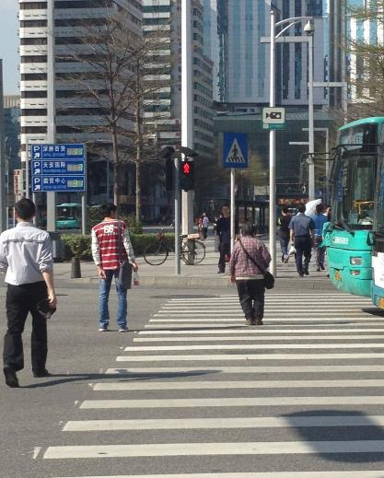

Slide 13
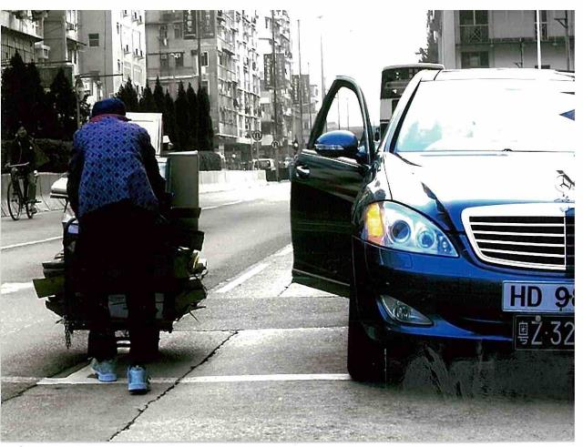

Slide 14
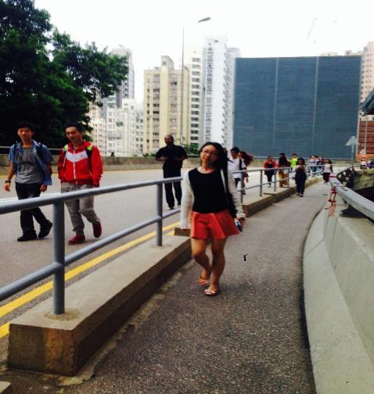

Slide 15
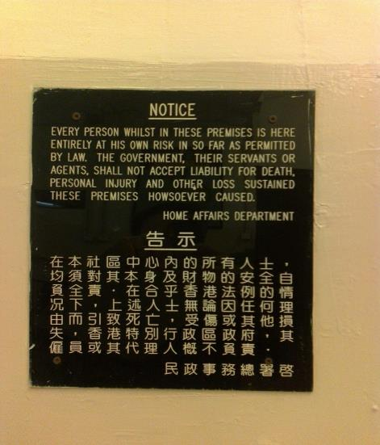
15

Slide 16

Characteristics of Tort Walk
Learning in context, uncover the social concerns that underlie the law (deep learning)
Independent learning: students identify/construct the artefacts of their learning
Habit-forming (1st photo discarded for a better one)
Capacity to foster life-long learning habits
Adaptability to other disciplines (see Tim Wotherspoon, “Simplifying Complexity”, Faculty of Science, HKU)
Labour-friendly, no teacher intervention

Slide 17

(2) Do you think the photo/essay is an effective learning aid for HKU law students? Why or why not? (26/27 = Yes)
As there is a high degree of flexibility, we may stumble into an issue that is not yet covered by lectures. Sometimes we would make wrong observations because of our unfamiliarity with the material.
By forcing me to engage the skills in a new way meant I had to fully acquire them first in order to manipulate them.

Slide 18

(3) What do you think are the main differences between this and other forms of assessed works you have done before?
- The fact that it involved an image, or actively seeking out something that showed the law at work, is not something I've had to do in any of my law assignments yet. The issues were also not very clear cut; the news items usually clearly have a leaning towards a certain legal idea or principle, but I had to work harder to identify it in an image and real life situation.

Slide 19
(4) What legal skills would you have applied and developed by doing the photo/essay compared to other forms of assessed work you have done?
- Linking legal principles to real life events.
It was more of going out of the textbook because I had to find ordinances, regulations that we did not have a chance to touch upon.
Applying knowledge to an unstructured scenario.
- I learnt the skill of relating the principles of the course on the real world. This habit of seeing the world through the lenses of tort law has stayed with me after the photo/essay was completed.
- The ability to discern and identify issues in a situation that hasn't been already framed in some way for me, using my own originality to form an argument or assessment of prospects. Also, by seeing a situation in reality allowed me to better recognise all the things that could have happened, or all the permutations of circumstances that could have been instead.

Slide 20

(5) Do you think the skills you have mentioned above would stay with you after the Tort law course? Explain. (26/27 = Yes)
Yes, as I think the practice of observing tort law issues in life will become a habit which motivates me to think about whether certain situations can give rise to a possible tort law action
Having practiced the skill to observe and pinpoint tort law problems in everyday life during the course, I think I will be able to gain new perspective of potential dangers and policy problems in real life.
- yes
- Please refer to previous answer.

Slide 21

(5) Do you think the skills you have mentioned above would stay with you after the Tort law course? Explain. (26/27 = Yes)
- I think so. Doing photo essay and writing RMD have made me developed the habit of observing what happens around me. I will automatically make relationship between the behaviours which are not proper with the tort issues.
- Probably not. It was only conducted once and other law courses don't seem to demand such skills as much as the photo/essay does.
- makes me more attentive to different situations
- probably yes. more observation on the daily life and bold application of rules to what is observed

Slide 22

(5) Do you think the skills you have mentioned above would stay with you after the Tort law course? Explain.
- Yes. The sensibility can only enhance when the course progresses and beyond the course.
the sensitivity to law issues outside school
- yes, because tort law is really about daily lives - so in general this assignment can effectively apply what we learn to daily life instead of limiting to textbook theories.
- Yes, because now I find tort and criminal have much overlap. It will assist my legal study I expect.

Slide 23
(5) Do you think the skills you have mentioned above would stay with you after the Tort law course? Explain.
- Yes, I think so. Even now I find myself seeking out issues or how a certain principle or ratio would apply in scenes I see everyday, most particularly in the middle of traffic. It's really refreshing because now I know how to actively seek these things out, and then identify the principles that would apply, rather than contriving a situation to fit a principle I'm learning. I think that will stay with me not just in my legal studies, but in my literary studies as well.

Slide 24
Video Documentary
A brief description/example
A larger scale optional group project (4 self-selected students per group) carrying 20% of the course (reduces final exam weighting by 20% (answer one fewer question)
Develops an understanding of the law in social context; skills of legal analysis and opinion-forming; students learn the law independently and in parallel with classroom learning and readings

Slide 25


Challenges and Benefits
Some of the challenges:
Grading: reliability; subjectivity of grading; every photo, every RMD is different; multiple markers, multiple standards?
Some of the benefits
To the students: students take charge of their learning; the learning is sustainable
To me: learning happens on its own; the teacher and the classroom become less relevant
25
Notes:
25

Slide 26
Sustainable assessment practices
1. Design assessment to help students achieve the desired learning outcomes (constructive alignment)
2. Use diverse forms of assessment (there is a diversity of learning outcomes)
3. Design assessment with community relevance
4. Design assessment to take into account the broad social context
5. Wherever possible, use authentic assessment problems
6. Design assessment activities that are similar/relevant to expected career activities
7. Use feedback practices that are dialogic, and that are likely to engage student learning
26
Notes:
26

Slide 27


Real-time Collaborative Feedback
A brief description
Http://moodle.hku.hk/mod/page/view.php?id=619548
For tests, examinations, and common assignments
Characteristics of real-time collaborative feedback:
timely, dialogic, collaborative, student ownership,
an appreciation of the indeterminacy of law
“Feed-forward”-the opportunity to use feedback
Relieves pressure on markers: students already know the standard of their paper
http://moodle.hku.hk/mod/forum/view.php?id=802815
27
Notes:
27

Slide 28

Real-time Collaborative Feedback
Survey results
See link
http://www.assessmentproject.com.hk/files/Survey%20of%20Students%20-%20Post%20Exam%20UGC.pdf
28
Notes:
28

Slide 29
Enhancing Feedback
Returning the scripts:
Brief description
Survey results
See link http://www.assessmentproject.com.hk/resources.html
29
Notes:
29

Slide 30

Activity-based Collaborative Learning
The Flipped Classroom
From passive to active learning
From content-centered to inquiry-based
From instructional paradigm to learning paradigm
From teacher-dependent to independent
From “sage on the stage to…guide on the side”
A wealth of pedagogical advantages
See Oxford Brookes U, “Twenty Terrible Reasons for Lecturing” (synthesizing the pioneering work of Donald Bligh and Graham Gibbs)
https://www.brookes.ac.uk/services/ocsld/resources/20reasons.html

Slide 31
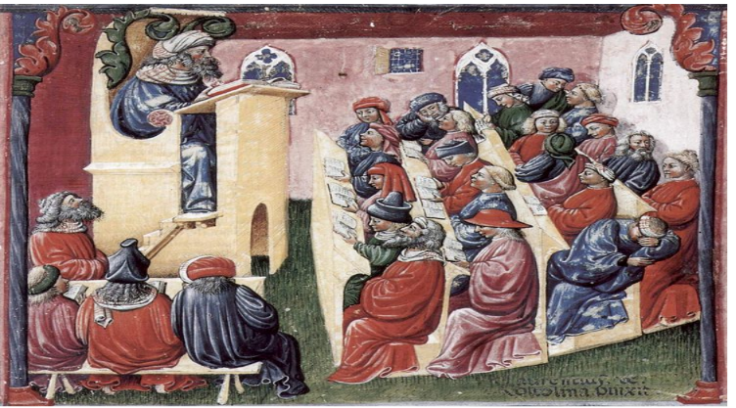
Educating the Next Generation
A depiction of the University of Bologna, Italy, 2nd half of 14th Century
Notes:
http://en.wikipedia.org/wiki/File:Laurentius_de_Voltolina_001.jpg
A depiction of the University of Bologna, Italy
2nd half of 14th century
31

Slide 32
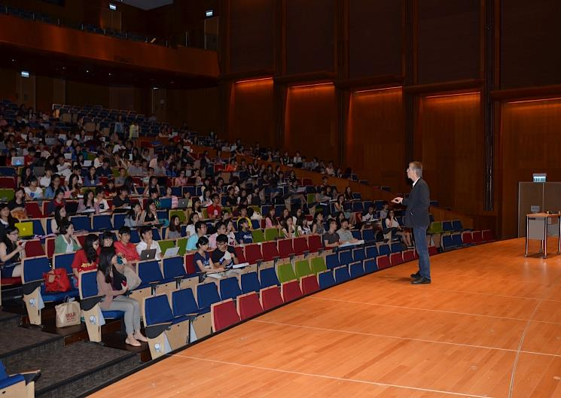

Slide 33
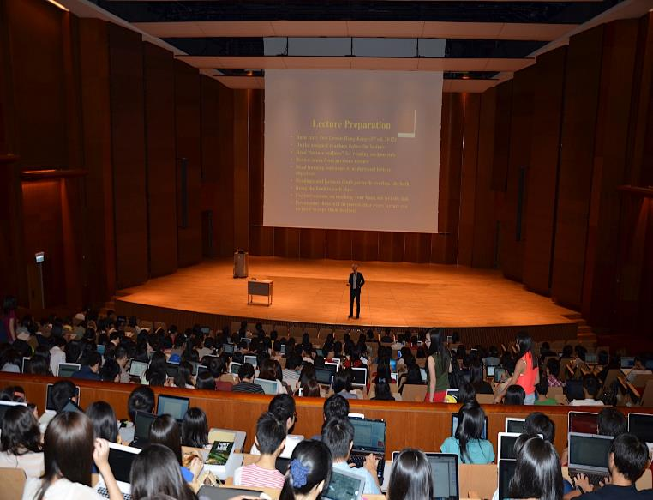
Notes:
http://en.wikipedia.org/wiki/File:Laurentius_de_Voltolina_001.jpg
A depiction of the University of Bologna, Italy
2nd half of 14th century
33

Slide 34
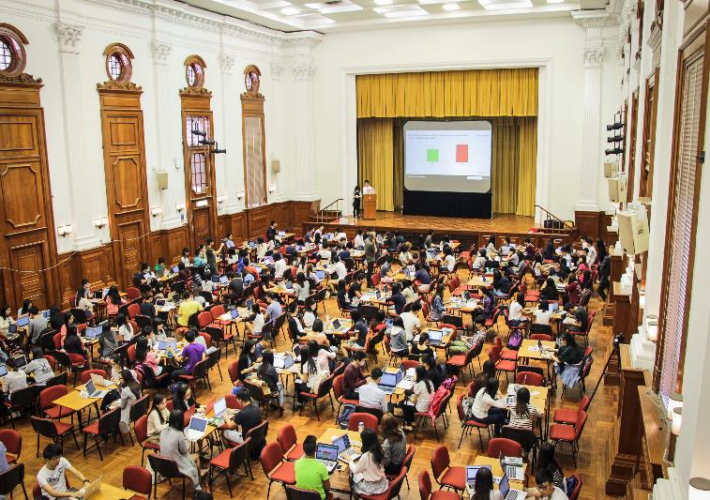

Slide 35

see pre-flip survey on usb
https://youtu.be/latTCUSOE34
(from 8 minutes)
https://drive.google.com/file/d/0BxmcC8nrnYLId0YydHZHZkdNREE/view?pli=1
http://tl.hku.hk/elearningblog/?pid=18128

Slide 36
Survey analysis

Slide 38
Some references
Assessment Futures (D Boud): http://www.uts.edu.au/research-and-teaching/teaching-and-learning/assessment-futures/overview
Enhancing Feedback (D Hounsell):
http://www.enhancingfeedback.ed.ac.uk/index.htm
Teaching for Quality Learning at University (Biggs and Tang, 4th edn, 2011)
Glofcheski, “Re-thinking Teaching, Learning and Assessment in the 21st Century Law Curriculum” in Legal Education in the Global Context, Ashgate, 2015
Glofcheski, “Making Assessment for Learning Happen” in Carless, Glofcheski et al, Scaling Up Assessment for Learning in Higher Education (Ashgate, forthcoming, 2016)
Glofcheski, Assessment Project: http://www.assessmentproject.com.hk/
38

